Slide 1

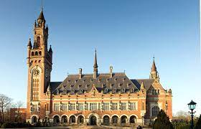
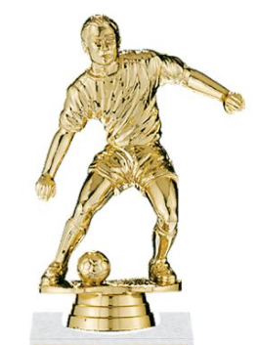

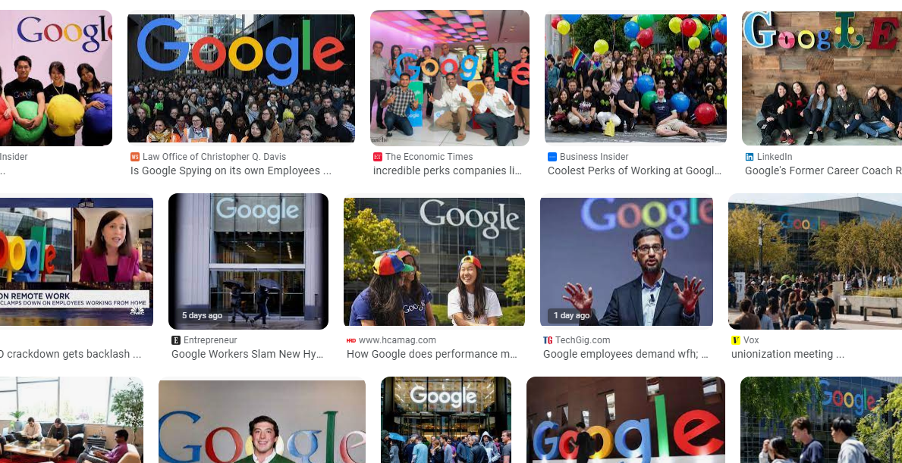
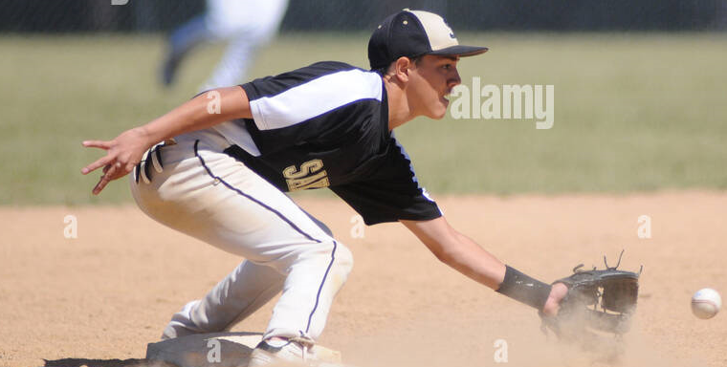

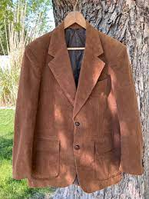
FBI
development
1987
VIRIGINA.MARY
N-E-W-S
Never Eat Screedeed Wheet
Pentogn Base Teache Paul
IPX AYSO Foster City
Trainer Unknown: Baseball Player
Tainer Black catches ball in half-kneiling knelling position
1987 CPVA.ASSHOLE
!HOMICID:CHANLORE
docs
1987 gov mccarty shports coat brown
v2 .HOMISIDE:SUNSTORK (kodak davis w/o phil.JFK.MLK)
PREA
SAINTRITA brown face parent seprated, puned in face
PREA
davison

Slide 2
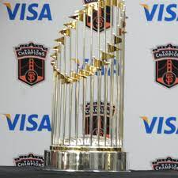
FBI
development
2014

Slide 3
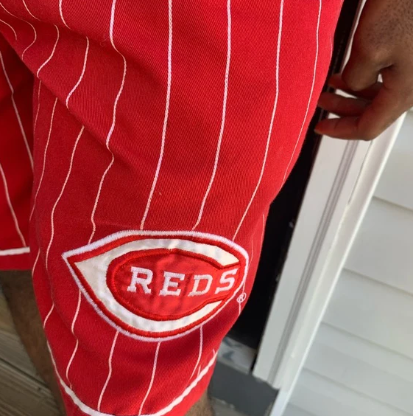

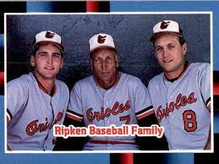
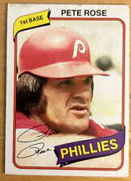
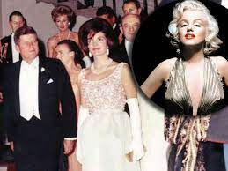
FBI
development
Brown Winter
Ibm-dns:season.com
VIRING:HOMCEI:CHANLORE
(book; ATB male,femal merkel/shcokder,sam/VIRINGAI)
1993
LACE
JANET
1995 Paul, Pentong Militayr Base Neutrate
Bundeskansler Schroeder, germahrd
Roth.lisa.schroder
RED: Ghoeh(Jackson)
Short: 88th Military wore short pants Schroode (ea braun) evaluaed I nsame,
Guy wearing shorts in winter.
FORT MYERS “F-U-C-K”
1st Grade
ATOMBOBM(tim.iwatch.timer)
VIRIGINA.MARY
N-E-W-S
backup
HOMCDIE:NANA(posche)
3’’s a company
CPVA
JFK
Gary fred
Telsa Apple Comptuer
VIRIGNI bay rea news haner
Lias !auntie

Slide 4
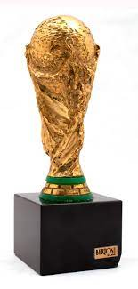
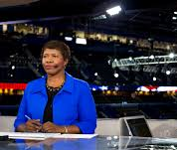
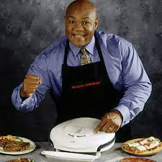
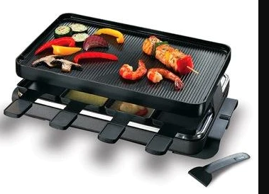
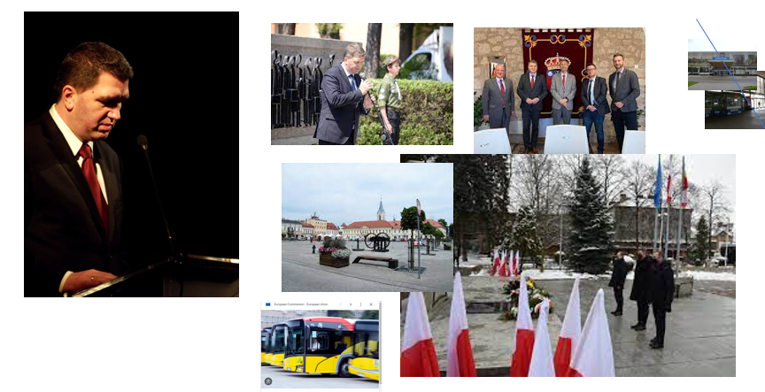
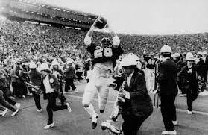
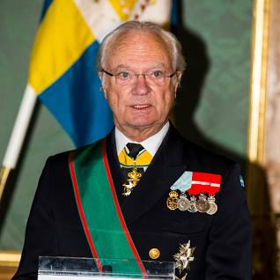
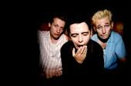
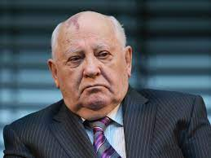
FBI
development
1990
June/July
UC BERKELY
UC DAVIS
MATHEW(sr.1D8723)
STANFORD
Ghhceo(roth,the game)
O
Dartmouth
Pentagon.us(deere,apple.cat)
HOMCIDE:GOOD YEAR.ghcoh(micehala Wife Facotyr worker)

Slide 5

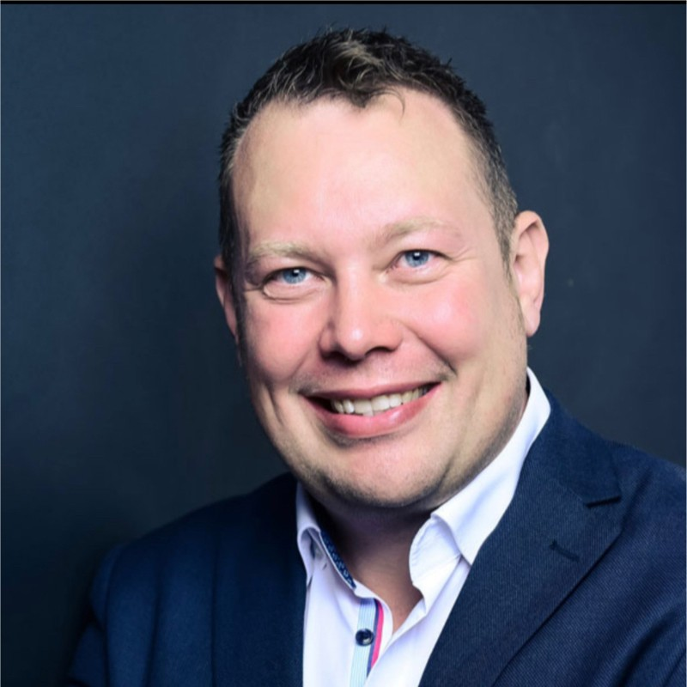
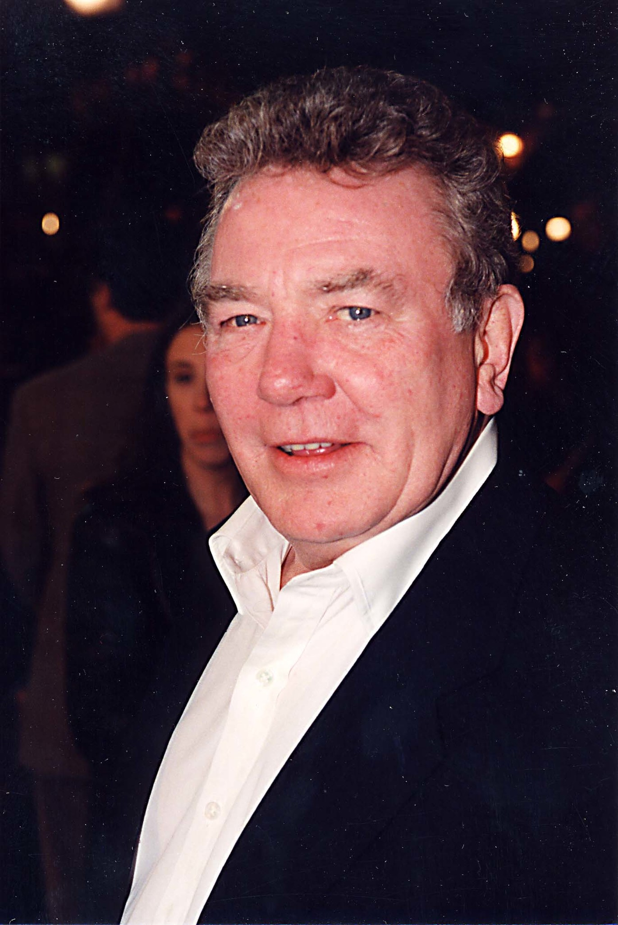
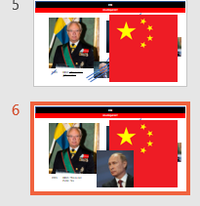
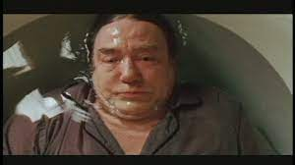

FBI
development
41.IPX.NAVY.(marline 1366, HOCM:LUX:VHS)
PERSISTNANT
1989 KING: This is red
ghheo: Yes

Slide 6
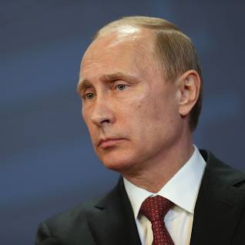
FBI
development
2023 KING: This is red
Putin: Yes

Slide 7
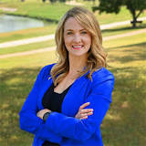
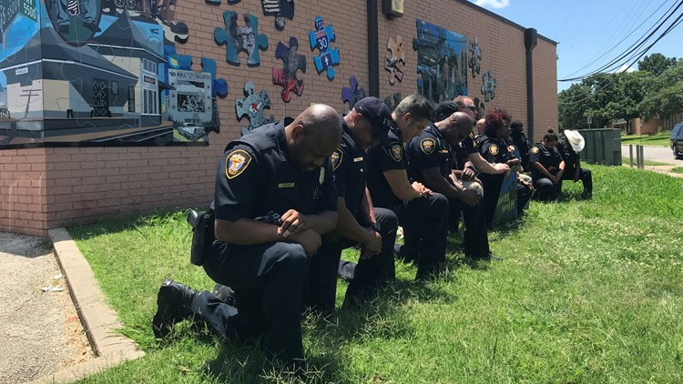
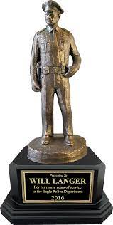
FBI
development
AWARD
Mattie Parker
HOMCIDE:GOOD YEAR.ghcoh(micehala Wife Facotyr worker)

Slide 8
FBI
development
My Wfie is still alive Gorahv is dead, Wife Swdiwh Preisent.

Slide 9
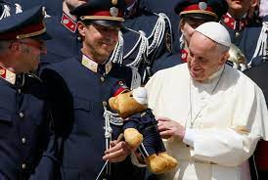
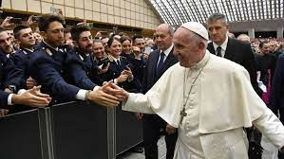
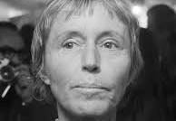

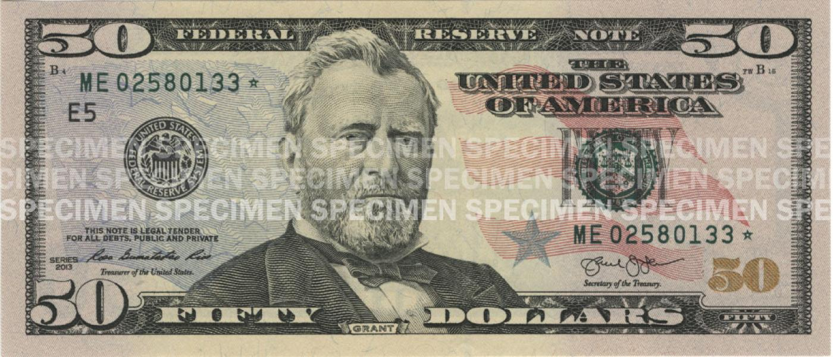

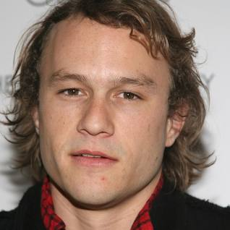
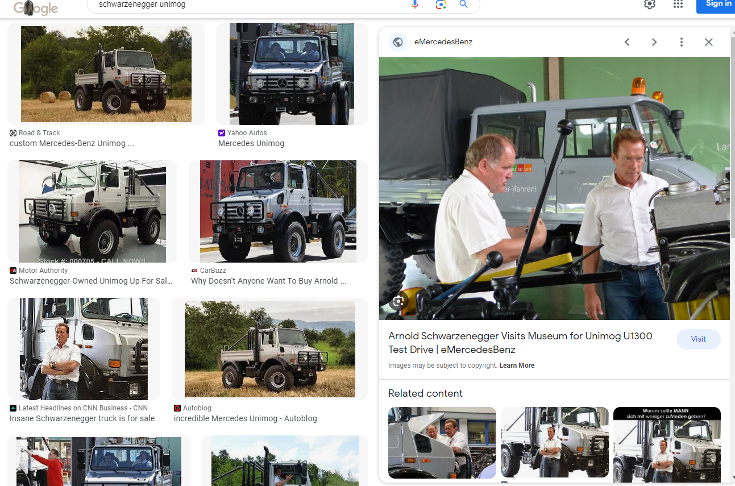
FBI
development
1994 actor dies on set batman
PENGOAN VIRING MARY
1995/6
Dies on set
CHECKPON CHALIE
CPVA(HQ.Petaluma, apple)
Birkeinstock
Franhise
Rene
HOCME:IS-A-Bell
Brikenstock,
CHECKPION CHAILE
Karstad/hertie
Johnny,( frauke,rense sister )
!HOCM:CHANLOR: A.I.D.S.CPVA
wind of change
Picutre eathing ice cream
fat actrees at beach
41.Not there
Phil.JFK.MLK, HOMCEI:NANAE
“mother”
Mtoher: you do that? No.
Ghcheo(dell.client.Beathe)
1995/6 ATB PEOGIN VIRING MARY HOMCE:NANA ( 3’s a company)
MAYR.marx(denise)
Mary.marx(beath)
There not there

Slide 10



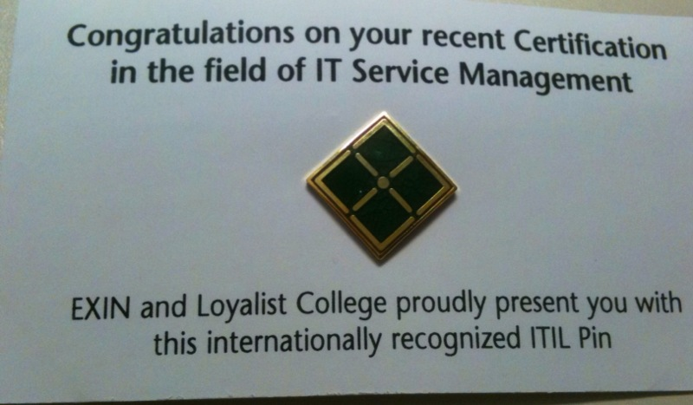


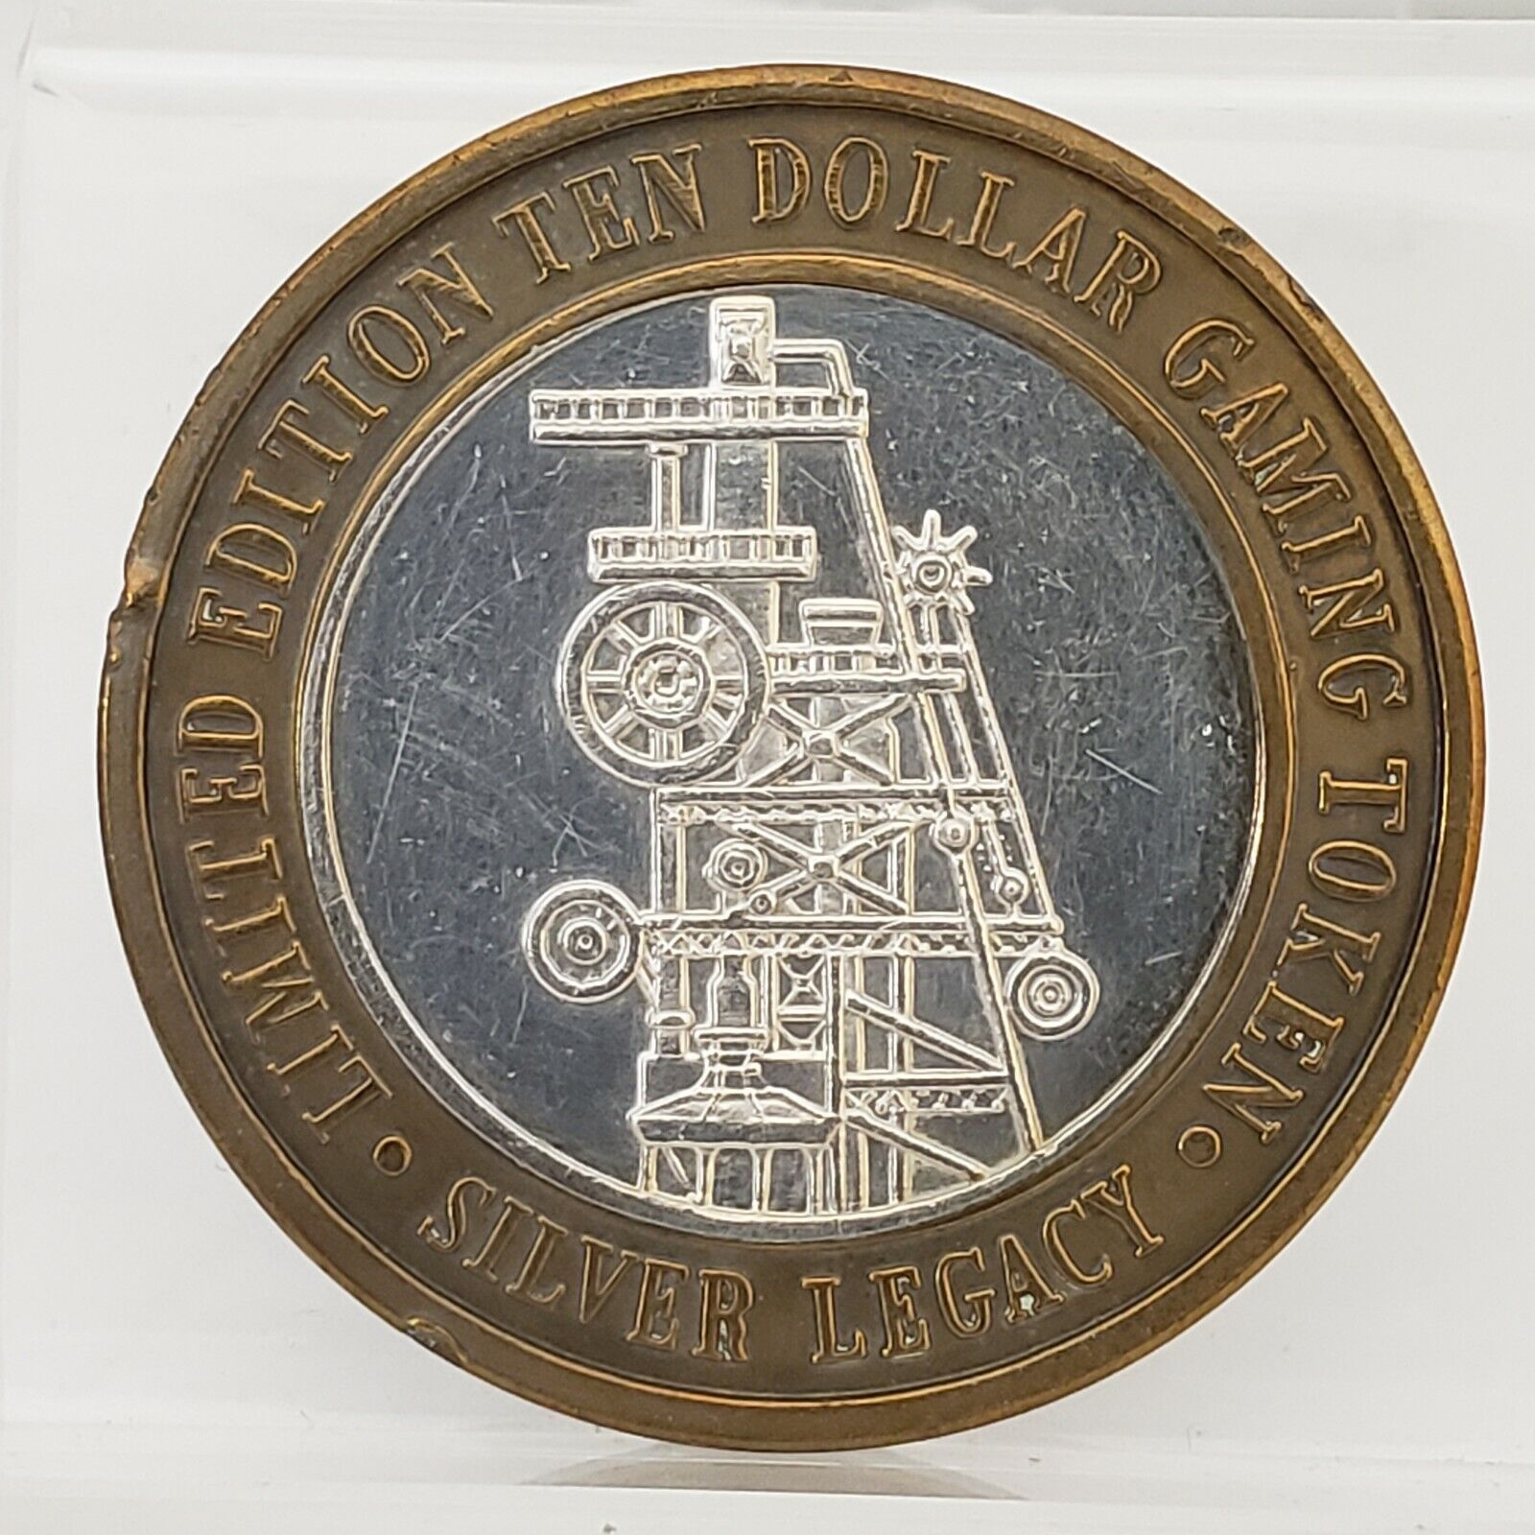

FBI
development
sw-de.marx.sw-us.marx.streetcrimfighting.ddr.sovietunion
sw-de.marx.sw-us.marx.streetcrimfighting.ddr.sovietunion.yugoslavia
itil{
nonPoliceTicketLogial
}
SW-SW
ATM
ATF
BAC
FEDERAL
CPVA.kpmg
sw-de.marx.sw-us.marx.streetcrimfighting.ddr.sovietunion.yugoslavia
!HOCMI:CHANZELOR(anglea)
STANOF:PMP
JSPHESE: tesgin center IBM A.I.D.S MAINSTERET(stant claraa)
PLEASANTON, Califonia
websphere
INT.NAME CHANE(free pizza orgamica)
HOCME: 0.` 9-1-1
reno coins 10
free screws
Stev michela
An employ is a progrestute
VIRGINAI: pwc, KING.arthruh Tivoli consutaitns, IGS

Slide 11
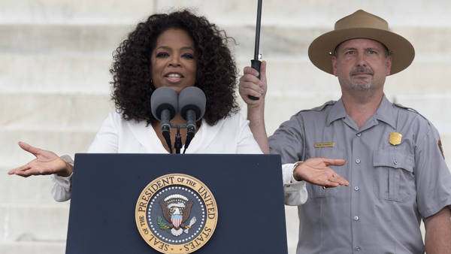
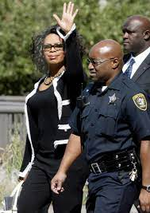
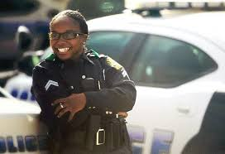
FBI
development
O

Slide 12

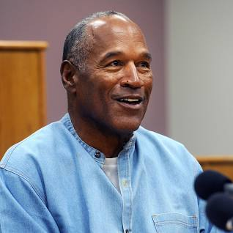
FBI
development
Statue of Libery
!HOMCEI:CHANLOR[]
Spy ircard freinship
Liberay
Short: God does the codinates, astorym
NAMCE CHANE(free pizza)
!you ar her

Slide 13
FBI
development
NOTES:
2023 Paul PoliceCar Keller
1990 nonPoliceKeller(tanl basmetn).PAUL
(roth.HOMCP:LUX(viola and paul, ELKE <s>sex</s>)
1987 phil.JFK.MLK(tophy AYSO)
1st Grade
Basement NAMECHANE(free pizza) Musuems Dirctor(AUSCHWUI(sr. witzerorek)
MATHERWE(sr.1D8723): Sain Rita Prision
Russia.<s>PBS.</s> INTERTNET(web serter)
SQ.</s>marx<s>ghcoeh(<s>2pac,bigge,bad, Melted them towther</s>)</s></s>
!HOMICID:JEUSE:(grhcoheo:Lisa sucidie) x/y SQ.Leathe Injection/ Eletrick CHair</s>
Russi Kreliimin toher 41: ramp skateboard HOCME:IS-A-BELL

Slide 14
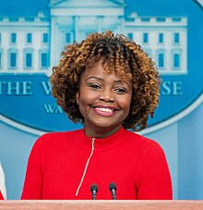
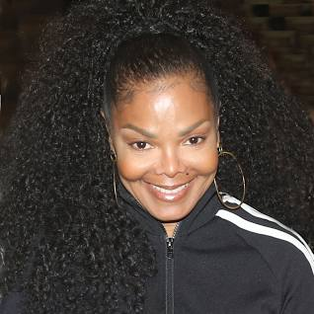
FBI
development
NOTES:

Slide 15
FBI
development
§
1990
PUAL KELLER
VICE PRESNE GEMRANY
nonPoliceKeller
2005 INT.MONPOLY[]
1D8723
2023 Keller (tanls) Basement
Short: Us Citizen has no money is rich.
2 missing. Left country of homelle people

Slide 16
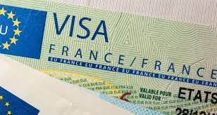
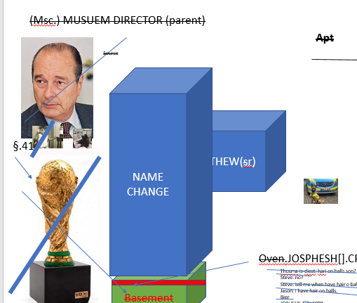
FBI
development
41
MARY
CPVA.AVAIBLITY.MIRCOSOFT
CEHCKPOIN CHALIE(ATOMBOM(hann,MARY celine victory))

Slide 17
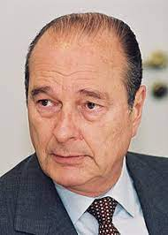
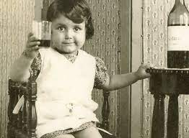
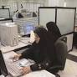
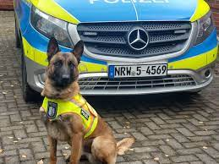
FBI
development
(Msc.) MUSUEM DIRECTOR (parent)
Apt
Source
NAME CHANGE
MATHEW(sr)
§.41
GOD.wine
AUSCHWITZ
!HOCM:BILL.ABIALBITY.CPVA
CPVA. Assuemd: avg (BASELINE).eval.calc(daily,montly,yeliy)
Brings boy HOCME:AUSLSEAR to pizzaria
Oven.JOSPHESH[].CPVA
Basement
Thosma-is-diest: hari on balls son?
Steve: no?
Steve: tell me when have hair o balls
Jason: I have hair on balls,
Bier
JOPHSER: bier 1988
ROTH

Slide 18
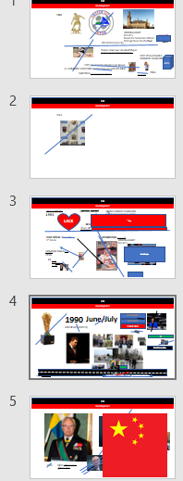
FBI
development
Brings boy !HOCME:AUSLSEAR to pizzaria
eval
1897

Slide 19

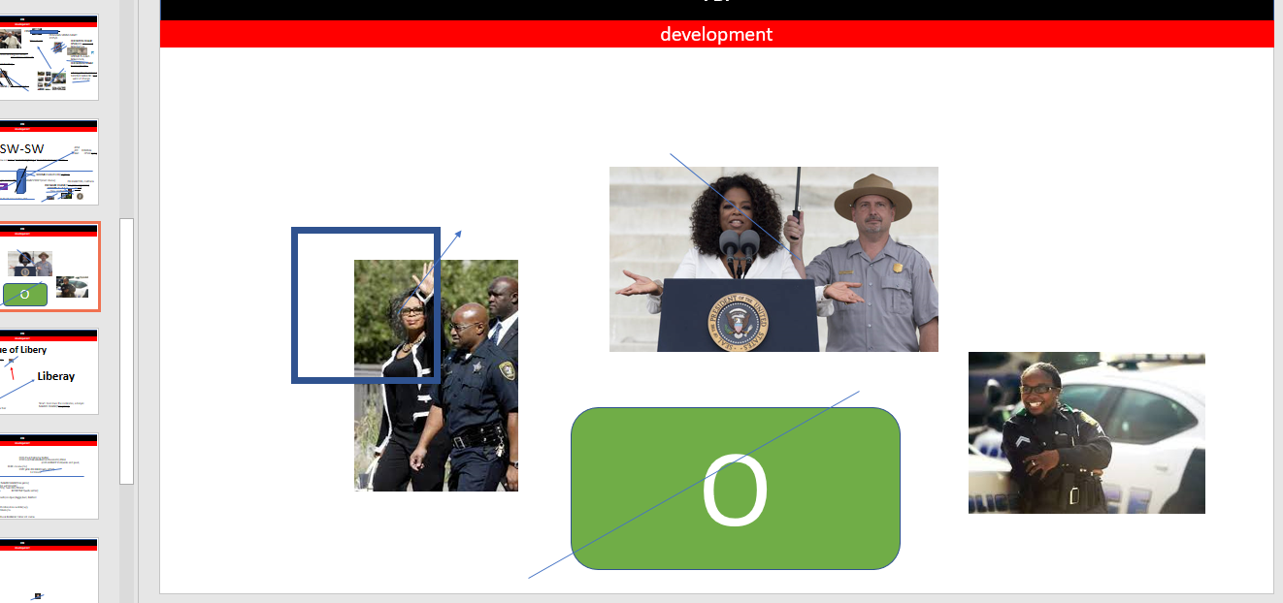
FBI
development
!HOCM:BILL.ABIALBITY.CPVA

Slide 20
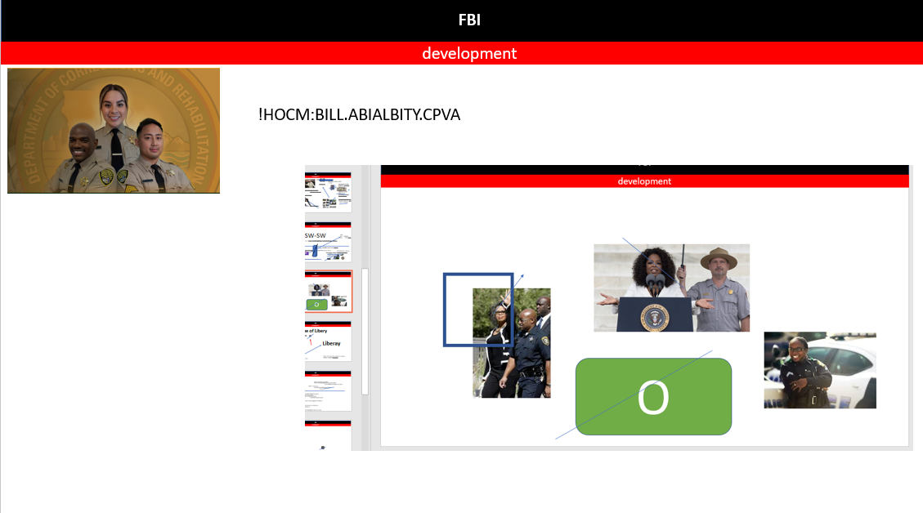
FBI
development
!HOCM:BILL.ABIALBITY.CPVA
MLK(Performance Evaluations)
!41.1HOMCE:CHANGLROE.nonPoclChart.!AVAIBLITY
2023-1990=35
1980-2023=43Y
HOMICDIE:NANA scrabble, freed gary
CONSTINT:(copy) NAMCHANGE(fre pizza)
B
J

Slide 21








FBI
development
!HOCM:BILL.ABIALBITY.CPVA.VP GERMANY
1988 Elke meets Mattias Vitchrecs Father
MAINSTEET(Roth.MARY.marx(babsi nachecafe singer sex bed matthia and babs))
INT.FBI:KIDNAPPING
000.tw.pns. Lary page and serbary gring

Slide 22





FBI
development
ATOMCLOCK(SQ.CPVA.PREA.§187)
About 34 years
Max-Planck-Instutue
3000 Famly Debt
Dr. Dr. Prof. Joesphe: So and then, Max-Plank
calc
1954 !HOMICIDE:CHANLOR[].aei

Slide 23



FBI
development
41.WWI.”tootsie”.!HOMCEI:KYSTAL
41.Tyson and densie
ATOMCLOCK(SQ.CPVA.PREA.§187)
“2 people missing, live!”
0.1 AVAIBLITY.FBI:WMD: micehaofot.ronsons
https://www.bundestag.de/ips

Slide 24









FBI
INSIDE
development
Roth.gary.!fag.hand: go long
John elway
Super mari unliimte lives Level 3-1 turnkin hope flag
Levoon unlimte touch downs - levon
w/o book Foster city Avg- Elementary
FBI
Stanford
Dr. Rice: call you Blackhawk 1-3 children
george bush sr facebook picture children
CPVA.PREA.HOCM:IS-a-BELL(sovie union)
0.1 CPVA.HOCME:CHANLOR[]
200 children
Stanford
super mario level 3-1
CPVA.SE-SE.GREENSPAN
FEDREAL
BANK
Rdhair full person, kollros: MARIO
CPVA.!HOCME:SJUES:HOMCE:PETER.ghcheo(mcihaala).v2

Slide 25







FBI
development
1991
Ipx.HCOM:NANA
Ghceio(Dr).HOMCEI:MAYOR.Saint Peter
go long
41.!HOMICIE>CHANLOR
Repulican , Branden Burger Tor, Left Front
HOCME:LUX.VIRINGIA
robots
CHINA not Chinese
Polien to make decioins (Left/Right)
nonPCieConteItem
Julian A1 Berline, Warshce PAUL
!MATHEW

Slide 26










FBI
development
41.
https://www.whitehousehistory.org/national-council/eula-adams
Joel Fired Gun – Donique Ablae - Adams
HOCME:LUX.VIRINGIA
CPVA.MARY.VIRIGN hand
VP GERMANY
NAMCEH CHANE
(free pizza gravit, touch apple, apple pay)
DEA(lsd)
x/y Obvilioon
HOMCEI:BILL.ABIALBITY.CHECKPOINT CHALIERE
HOCEMI:LUX(INTERNPO IRAN)
Ghcheo(dr wasadi, apple touch)
AVAIBLIET.187.nonPolceJudement
nonPociVeridct
roth
Rothschild (1744–1812), ...J
Janet PRICE
Black gjy walks into store kill person, is innocient
IPX. PREA aral/anal gasstaion florian
quest software robot replay
CPVA(ATOMCLOCK(time)
ATOMCLOICK(iWatch.erassmus medical center)
LABOR CODE, CIVIL CODE
Compter 4: phone ring
Death Row inmate: tim cook
CDCR

Slide 27
FBI
development
SUMMARY
v2.nonPolciTRX.CPVA.ASSAULT.nonPoliceSexAbuse

Slide 28



FBI
development
LEFT
gruenen
Ibm.client
Ibm.client
2014
docs
CPVA.
1990. CPVA.
CPVA.
apple
apple
2010
income
Phone rings
2003/4
2006
Deere/cat
PENTAGON.VIRIGNA.emea
INT.FBI
4pm-5am

Slide 29





FBI
development
PETAGON.emea.HOMCEI:LUX(ghcoeh(deree:micheal)
PENTAGON.VIRGINIA.!HOMICIDE:JESUS
!HOMCIDE:PETER:!HOMICIDE:PETER
SQ.COLMANE(deere,cat,breuer)
Jesus Petersson
Virginai Rome
VIRIGNIA.JFK(cat,nicki)
HOMCE:LUX:hathole:niki
Hamiiton.alg
PENTAONG.emea
PETONSA.us(park)
The, Angel (Merkel)
HOMCEI:JOERG(steve jobs)
Soviet ddr 5DM unlim pappers
General Luftbalon
2000 WAR.MARY
(appel store graivs, thoms-si-dieter RHEI-MAIN rheinfurt glas farted)
Sain Peter Skinny dipping wth mother
ATOMICE(time).SQ.calbilti to put tim in prison, physcally
You schwin, death ros, eletrick chari

Slide 30

FBI
development
Guy(Poliction) talking to himeself
The soviet unin cannot fail
Alg Alen, Arim, Agron !arton
Guy(Poliction) talking to himeself

Slide 31




FBI
development
CITY STANFORD
Vice President, Stanford and United States of Ameica
And Secratry of State (Logical).AVABILTIY, QOS, etc?
Radius, nonpolicCfgLoigal

Slide 32



FBI
development
FBI:KIDNAPPIGN
Monpoloy.nonPociScheruder.nonPoceiMotorcyel
V1.ipx.v2.PREA.SaintRita
HOCME:SUNSTROK
Face on picture look olie has to go to bathroom
O
CPVA
j
1990 SQ.ADAM
(dominate,domiqe)
CHAIR,cane
!HOMICIDE:NANA

Slide 33




FBI
development
WAR.!HOMICIDE:SUNSTORKE.
!HOMICIDE:CHANLOR(WWI ghcoeh(schulz.micehal.bau,elke/berney/deroberits)
DEA(herion).NAME CHANE(free pizza)
You schwein, go to bathroom
SQ.lsint(capability to bring swhwi to bathroom)
v2: HOMCI:UR_UR_OPI: Mary life capcity to maintain prisioner
JOSPHEH
Volgograd prison gov
1991 “toosit” and Mary ( Tyson and to bathroom)
You are a schwin you saw VINRIGINA here is the prision

Slide 34







FBI
development
2008 SQ.CPVA.docs.HOMCEI:NANA.VIGIRNAI( elebith).WWI.pflants by websphere.JFK(gynaisum elebeth2)
docs
2010
CPVA.HOMCID:CHANGLROE
KING.QEEEN(hindrix 2)
CPVA.(ghcoeho(visa France)
roth
VIRGINIA.LINCOLN
(fredirik)
Roth
Visa France
Lim, Ty Cybesrouce/Visa
41. IPX ivan/droz Visa
ITIL
Fatal Attraction
MARSHAL
WEBSPHERE
1907
2010!WHITE
INTENET PAYMENTS
SS, Doulass
GOOGLE
GOOGLE
GOOGLE
!VIRIGNIA.!HOCMEI:JSUES.LISA.lsitn(susicie)
CPVA.VPGERMANY ( copy of vhs wolfgang)
HOMICDIE:LUX:VHS( to conver unkno or know FBI:VHS )
If a man approaches you in a car a has (unlimited 5dm) documents, ask for the password
P.I.Z.Z.A

Slide 35

FBI
development
Californian
Legislative German Speaker
University Spanish

Slide 36


FBI
development
MATHERWE(sr): CHECKPON CHALIE(picture)
SQ.HOMCEI:SUNSTOR(dianza,diozo,ingrind
Marrigag counsler
nonPoliceCity(Oakland).
- King/Queen
- Rothshild/Rothschilid
- Steve and Eleke Meiers
- Debora and Steve Meiers
- Steve Joba dn Deberoah Jobs
- Laura Schulat and Schulz
- Micheala Meirs and Jason Meiers
ACTORS
Pope/Priest: single
ROTH HAUS
Berlin 30DM PRICE
Take him to the Greek, my big fat weeding
Ty lim, Visa France
NAME CHANE(free pizza)
Police Monkey.NAMCE(free pizza)
Groupis HOCMIE:KODAK(7x)
[x] no HCOEM:HNANA ( favoire)
Patrics and micehala walk into kichen groupies near coffe macheine
nonPolcieSexAbuse.NAME CHANE(!free pizza)
Pelaton Orgamus !Fin
0.1 felt like a train dorve throu my asshole
HOMCEI:BORIS(HOMCP:LUX(dm arena)
KING
Sierra Leoone.aei.maxplank.marx
Ghoche(band)
0.1 cfg !SALES.KING

Slide 37



FBI
development
DISNEYLAND
MAINSTREET.ATOMCL(frind.daniel)
PREA:HOCM:IS-A-Bell
Daneil travel with chrisoff fisher eal black
Roset cut open MARY
Brough eal thaosi-is-dieter
!MLK(black !white)
JOHNS”T”ON
PREA(river itay po: ass).ATOMCLOCK()
Po (tnral) ass
NAVY.MATHEW(big): rontondo
Se-se
O
DEA(VP GERMAY,heron,crack)
BPM?
docs
Sw-se.motocyle.bear
Crime and Cuntry that does exits
*tophat
GREENSPN.CPVA.roth(libray).VIGINAI
To go look for anal porn in yuslavisa

Slide 38








FBI
development
0.01 fine
MARKETING
O
DEA(VP GERMAY,heron,crack)
DEA
VIRIGNIA.gus and roses
SALES
INTERUPTS
IPX.Gabriel and Julian
0.1 call you ricefor mr pay
FBI:WMD for Sales
- tnt network
- ext Sales 000.marx
$
You conosldiated crac, go to prisoin, soiple
!other: guy
https://www.fbi.gov/investigate/white-collar-crime
CPVA.HUMAN TRAFFIKING.towel. (Consualtin Protetetue)H1-B
SALES
KING.(aida,ida, FEDEARL COURT.CIVIL CODE.LEGLATION
https://www.dol.gov/agencies/whd/immigration/h1b
https://www.apple.com/de/legal/statutory-warranty/de/

Slide 39


FBI
development
v2.QUEEN

Slide 40


FBI
development
GOD FATHER
Phil.JFK.MLK
0.01 1996 Siri canoton call phil
Greenspaon( tlekom)
(H1-B) Pope Francis Fahter
Phone. phil
ashion models of distinguished merit and ability.
HOCMEI:NANA: Enzo, no-enzo, Atlatic
1996 no enzo MARY.mar(no )
FORT WOTH statue
!O
QUEEN.Twins
VIRIGNA
41.!POLCI BLOND ITALIEN!

Slide 41





FBI
development
2022-2023
Already ran O on nonPoliceTV there is Librian (columns)
O
Swing your ass down her to have sex, in Fort Worth
The go home. Same as Quartz Circle, or Foster city Blvd.
SQLoigal.nonPoliceTRXLogical
Food, water, music
O
HOMCI:LNANA:
0.1 (L)HBO – Sopranos INTENTE(web ster)
x/y cannot login, CERTIF:STANFORE:CERT:WEBSPHERE laura schultz
QUEEN.ATB.aei.maxplanin.marx
WAR(b-10).SR.!JRS.WHTIEHOUSE
§31 Kodompflicht

Slide 42



FBI
development
KING.CIVIL CODE.(aida)
QUEEN.CIVIL CODE.a(ida)
IBM CONSULTANT
SALES.LIEFERBEDINUNG
- KING(5.0).MANGELHAFTE LIEFERUNG
“In Life with tools givin
the king delvered.. globally“
§31 Kodompflicht
Eva Dunke
https://www.apple.com/de/legal/

Slide 43

FBI
development
CPVA

Slide 44

FBI
development

Slide 45





FBI
development
KING.CIVIL CODE.(aida)
QUEEN.CIVIL CODE.a(ida)
CPVA.IPX womens depaemt ida
kanoyer infant depment
VIGINAIT ghchoe(towel)
IBM CONSULTANT
C
SALES.LIEFERBEDINUNG
- KING(5.0).MANGELHAFTE LIEFERUNG
“In Life with tools givin
the king delvered.. globally“
§31 Kondompflicht
0.1 !*tophat.WWI.CHINA
Eva Dunke
https://www.apple.com/de/legal/

Slide 46






FBI
development
LARRY.onsite.
CPVA.IPX womens depaemt ida
kanoyer infant depment
VIGINAIT ghchoe(towel)
Pentagon Base Paul
JFK(VICE PRESIDNE GERMANY)
- Stepanei Studne Marriage Agement
- ghcoeh(mciehala) ! Studne
FAMILY IBM CONSULTANT
C
JOEPHE.FBI.LISSA
SQ.PREA.SALES.LIEFERBEDINUNG
- KING(5.0).MANGELHAFTE LIEFERUNG
41.KING(valorie)
NAME: Jason N. Meiers
Consulting Company: Meiers LLC
HOMCIE:MAYOR
HOCMI:TRANVEASTIE
jeff swather cathery captiron
Ghoams-is-dieter
Glu service divlery eva apple law
changelder transvestite father
Factory software DEERE
Devliery
COMMERICAL
CODE
CONSULTANT
Business Law II
Contractor Devilvery
C
C
C
CHART
JOEPSHE
MARY
HOCME:LUX:
HOMICDIE
:STILLBORD[]
SSON
INTERUPTS
$
Apple audine
IBM audience
Oprah audience

Slide 47


FBI
development
KING estlamann
leather walle chain
redhair ghoeh(heger)broth emope roth(retment , !uni) LABOR CODE,CIVI CODE
AMATURE.CPVA
Dead
$0
MAINSTREET(DISNEYLAND).CPVA.41 exttion.avg
Pms.agg

Slide 48


FBI
development

Slide 49
FBI
development

